Slide 1
Oracle certified Java associate
Lesson 17
Andrei Dragutan

Slide 2

OOP principles
Inheritance
Abstraction
Polymorphism
Encapsulation

Slide 3
Encapsulaiton - definition
Encapsulation in Java is a process of wrapping code and data together into a single unit, for example, a capsule which is mixed of several medicines.
We can create a fully encapsulated class in Java by making all the data members of the class private. Now we can use setter and getter methods to set and get the data in it.

Slide 4
Achieving encapsulation
Packages
Access modifiers

Slide 5
Advantage of encapsulation
By providing only a setter or getter method, you can make the class read-only or write-only. In other words, you can skip the getter or setter methods.
It provides you the control over the data. Suppose you want to set the value of id which should be greater than 100 only, you can write the logic inside the setter method. You can write the logic not to store the negative numbers in the setter methods.
It is a way to achieve data hiding in Java because other class will not be able to access the data through the private data members.
The encapsulate class is easy to test. So, it is better for unit testing.
The standard IDE's are providing the facility to generate the getters and setters. So, it is easy and fast to create an encapsulated class in Java.

Slide 6
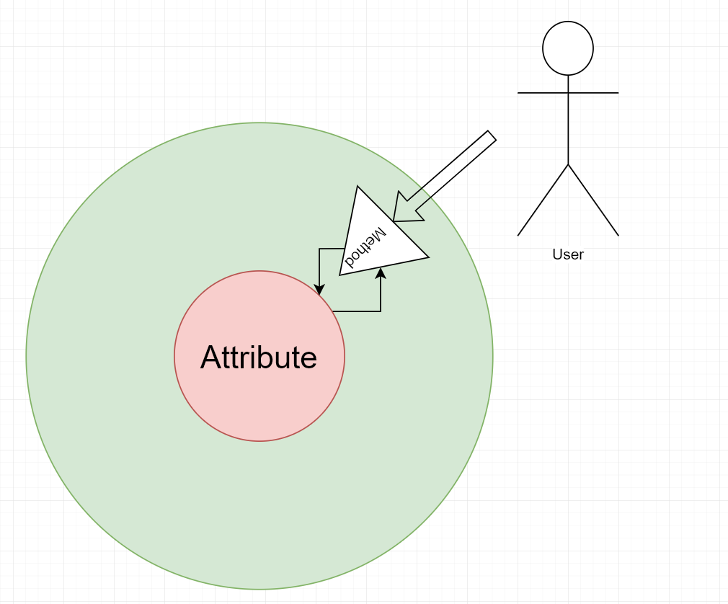
Encapsulation - definition

Slide 7
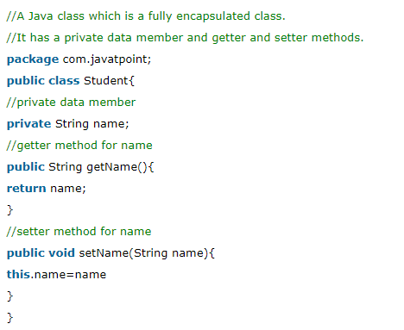
Example of encapsulation in Java

Slide 8
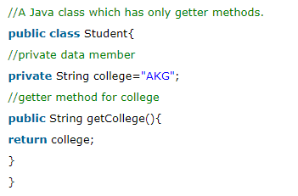
Read only

Slide 9
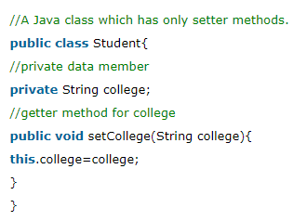
Write only

Slide 10
abstraction vs encapsulation

Slide 11
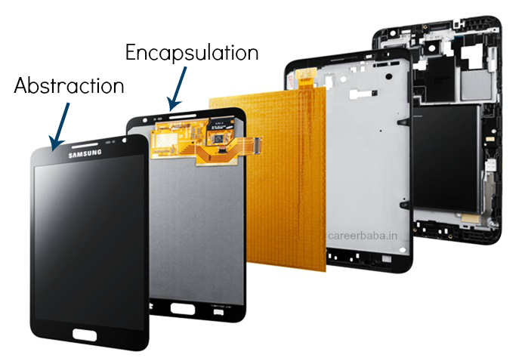
Abstraction vs Encapsulation

Slide 12
StringBuilder/StringBuffer

Slide 13
StringBuffer
Java StringBuffer class is used to create mutable (modifiable) string. The StringBuffer class in java is same as String class except it is mutable i.e. it can be changed
Note: Java StringBuffer class is thread-safe i.e. multiple threads cannot access it simultaneously. So it is safe and will result in an order.

Slide 14
Builder
Java StringBuilder class is used to create mutable (modifiable) string. The Java StringBuilder class is same as StringBuffer class except that it is non-synchronized. It is available since JDK 1.5

Slide 15
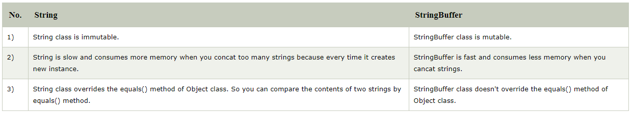
Difference between String and StringBuffer/Builder

Slide 16
Întrebări, sugestii, propuneri

